Slide 1

Heredity and Evolution
Evidences For Darwin's Theory Of Evolution - 2

Slide 2
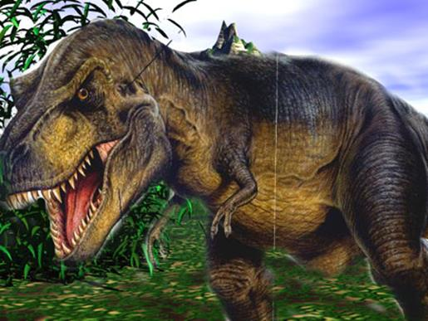
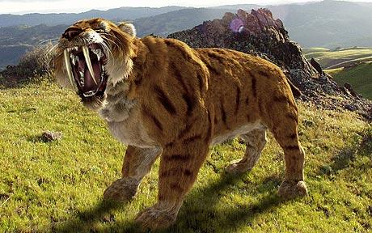
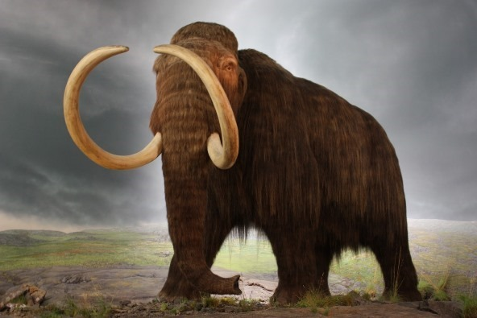
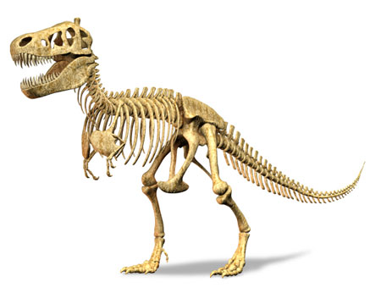
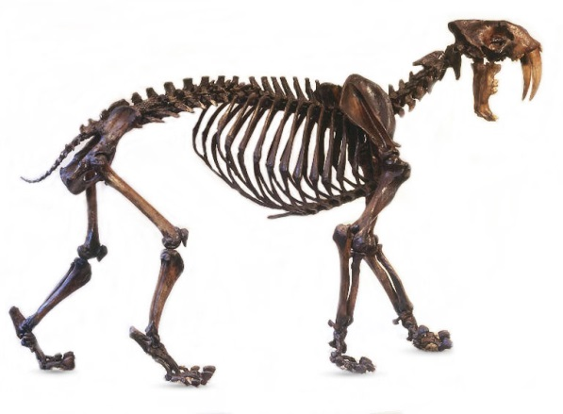
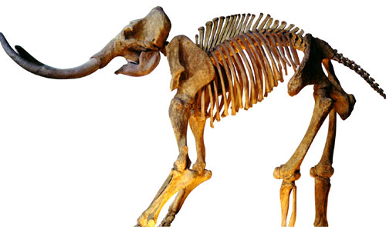
Evidences for Darwin‘s Theory of Evolution
Fossils
Studies of organ structure can be done not only on current species, but also on species that are no longer alive.
How do we know that these extinct species ever existed?
We know this from finding their fossils

Slide 3


Evidences for Darwin‘s Theory of Evolution
Fossils
What are fossils? and how they are made

Slide 4
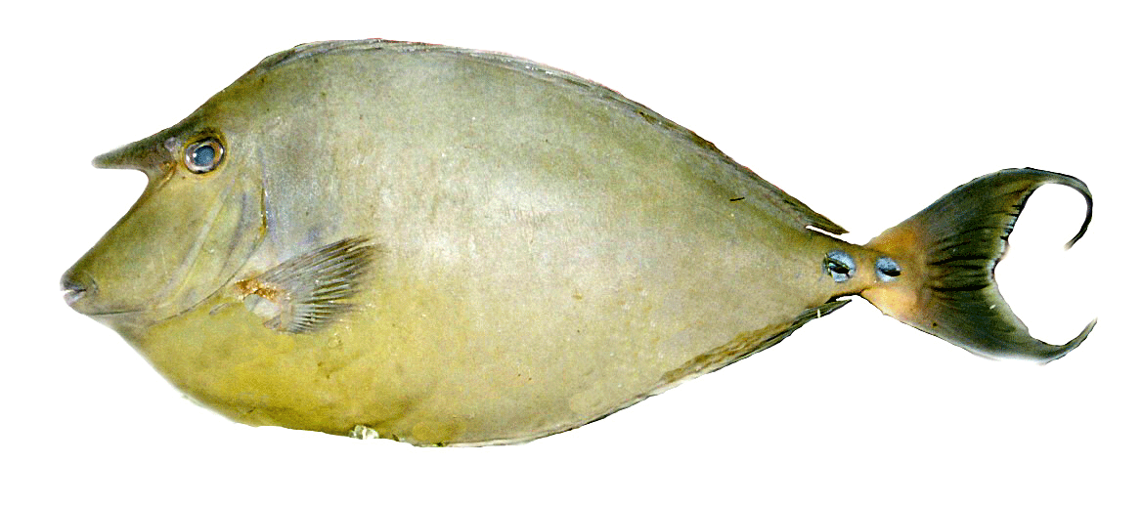



Evidences for Darwin‘s Theory of Evolution
When organisms die
Fossils
Their bodies will decompose and be lost.

Slide 5
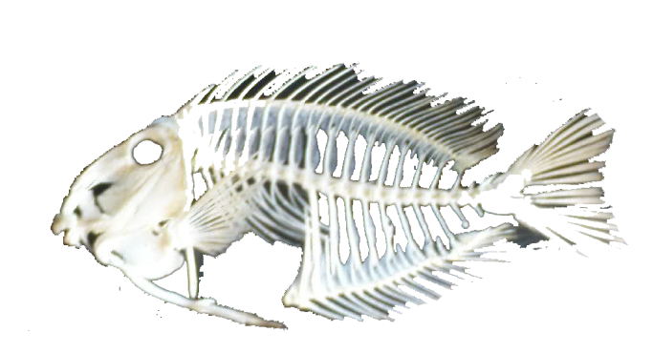
Evidences for Darwin‘s Theory of Evolution
Rock deposit on the fossil.
Ground water wash away the minerals.
Their bodies will decompose and be lost.
Fossils
The body will get buried deep under the sea bed.

Slide 6


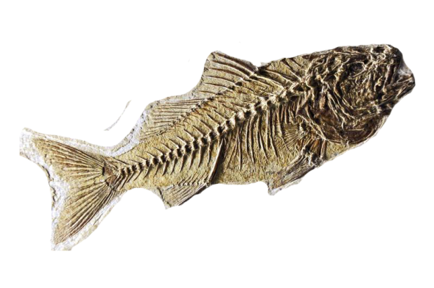
Evidences for Darwin‘s Theory of Evolution
100 years later sea bed converts into a mountain and fossil comes on the surface
Fossils
Rains wears away the surface

Slide 7
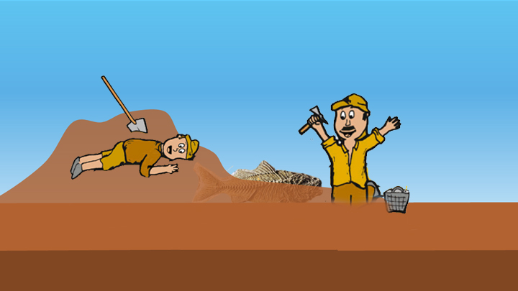
Evidences for Darwin‘s Theory of Evolution
Fossils
Archeologist digs the surface and found the fossil.

Slide 8
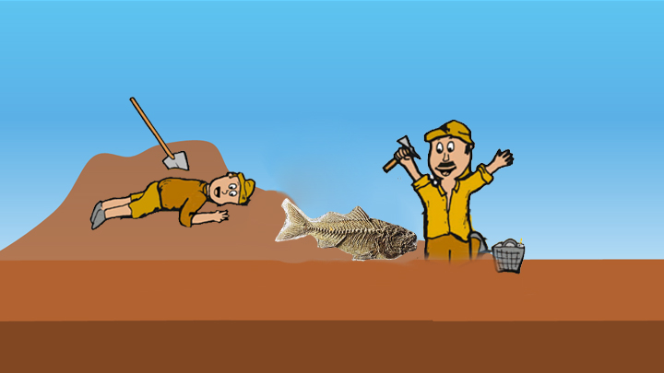
Evidences for Darwin‘s Theory of Evolution
Fossils
All such preserved traces of living organisms are called fossils

Slide 9

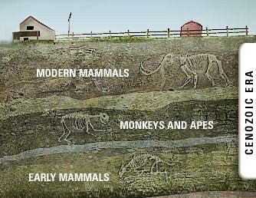
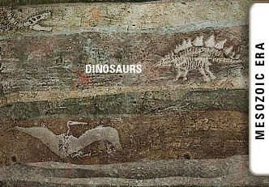
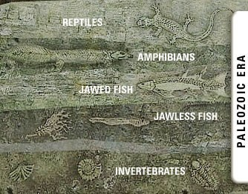
Evidences for Darwin‘s Theory of Evolution
Fossils
How do we know how old the fossils are?
Recent
Relative Method
Isotope Method
If we dig into the earth the fossils we find closer to the surface are more recent then the fossils we find in deeper layer.
Older
Extinct

Slide 10
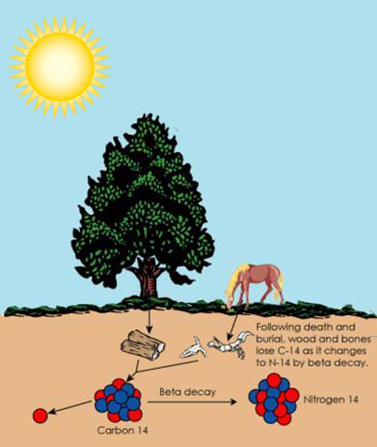
Evidences for Darwin‘s Theory of Evolution
Fossils
How do we know how old the fossils are?
Relative Method
Isotope Method
Detecting the ratios of different isotopes of the same element in the fossil material.
The amount of carbon decayed over the years will tell the real age of the fossil from the time of its death.

Slide 11

Complicated organs such as eye can not be generated by a single DNA. But will be created bit by bit over generation

Slide 12
But how can each
intermediate change be selected for?

Slide 13
Let’s understand this with a possible explanation…

Slide 14
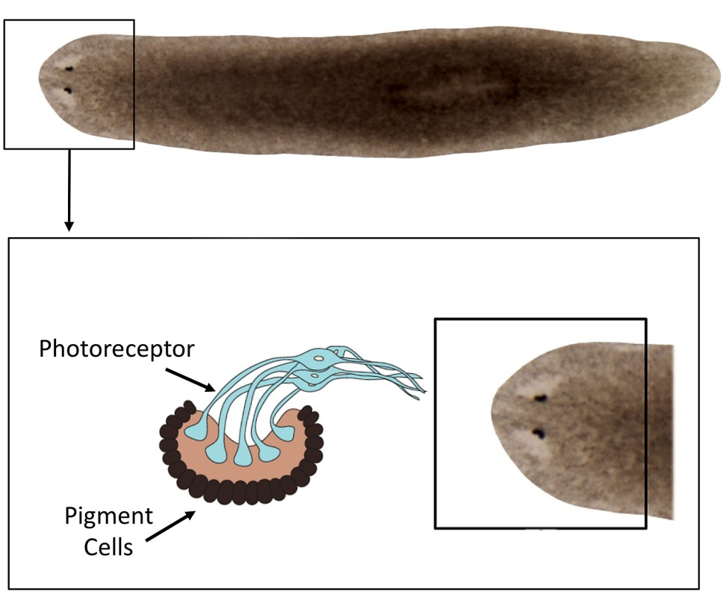
Evolution by stages of eye
The first basic eye was seen in planaria which were just eye spots which can detect light.

Slide 15
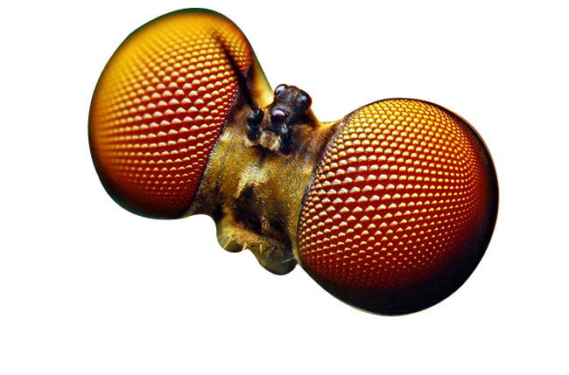
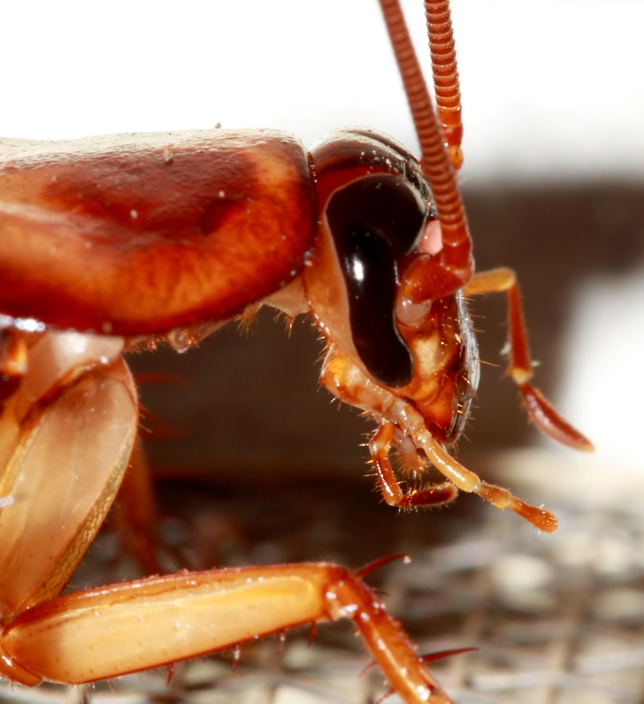
Evolution by stages of eye
The second evolution in eye is seen in insects like cockroach, who has compound eyes. i.e. many lens in one eye.
Lens

Slide 16
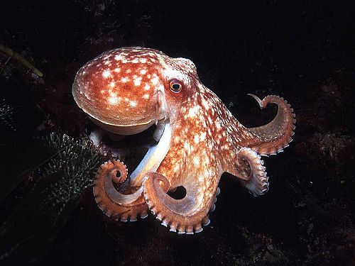
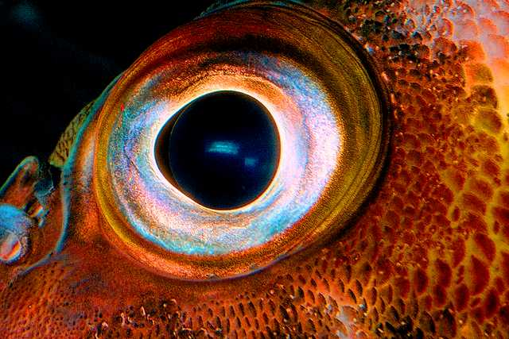
Evolution by stages of eye
The third evolution in eye is seen in octopus, who has camera type simple eyes with single lens.
Lens

Slide 17

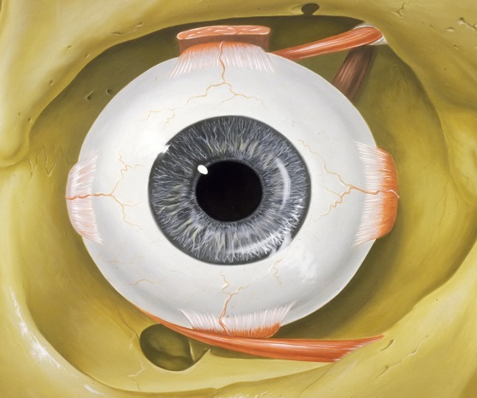
Evolution by stages of eye
The latest evolution in eye is seen in vertebrates, who has an advance eye with single lens.

Slide 18

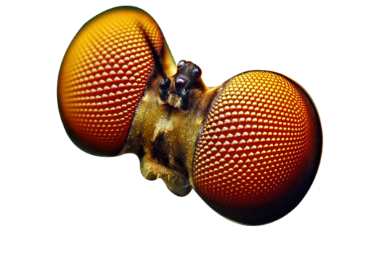

Evolution by stages of eye
Structure of the eye in each of these organisms is different.
Differences in structures of eye is enough for them to have separate evolutionary origins.

Slide 19
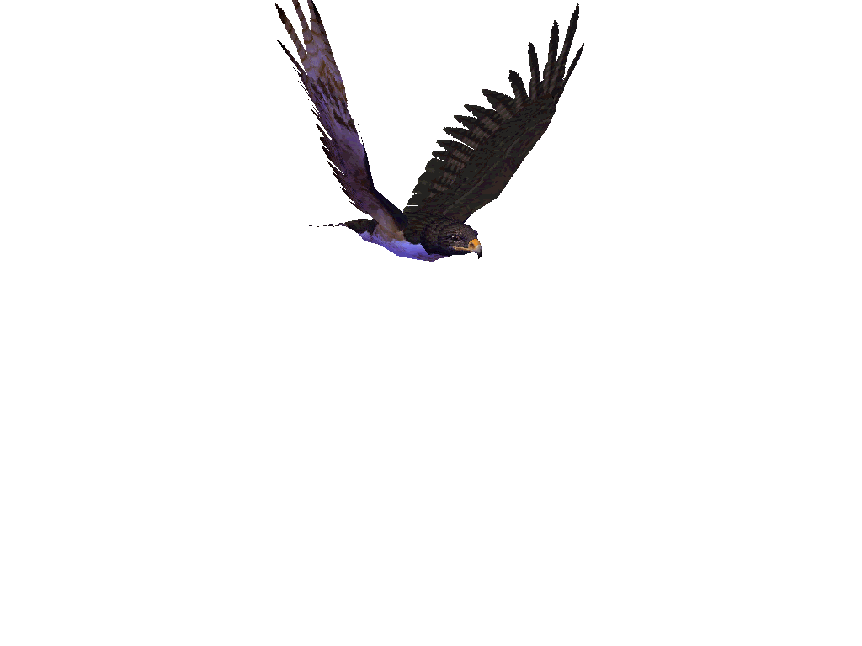
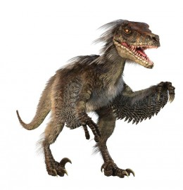

Evolution by stages of feathers
The first feather was seen in dinosaurs although they could not fly using the feathers.
These feathers got evolved and become useful for flight in birds.
This, of course, means that birds are very closely related to reptiles, since dinosaurs were reptiles.

Slide 20
Thank You

